Slide 1

Pre-Course Component
Course in Alcohol & Other Drugs Specimen Collection & Testing
Version 1
Notes:
Hello and welcome to the commencement of AWDTS ’ Course in Alcohol & Other Drugs Specimen Collection & Testing.

Slide 2



Pre-Course Component
Course in Alcohol & Other Drugs Specimen Collection & Testing
Version 1
Remove this reflection
Idea: Keep beaker (I can take a screen shot), but make smaller. Add medical people, industrial people, and a regular person in doing different things background high transparency to accent the different groups involved in the drug testing training process. People can relate to it.

Slide 3


Blue Stone
Where we are…
BNE SYD MEL HBA ADL PER DAR CBR
Gold & Sunshine Coasts
Surat Basin (Chinchilla-Miles-Roma)
Bowen Basin (Blackwater-Emerald-Mackay)
GLT, ROK, TSV, CNS, ISA
89 operational centres Australia-wide
NZ & PNG
Notes:
AWDTS LOCATIONS
AWDTS operates in all Australian capitals & major Regional Centres, and provides training in PNG and NZ.

Slide 4

Alternative View of location
Notes: this is more supportive of creating a mental model of where the locations are than text. We could make the maps smaller and still include the text, but I don’t think that is necessary. Also, should we include a map of NZ and PNG? Do away with the arrows? If we keep the beaker, suggested to knock out the reflection effect to focus on content. Too much screen is taken up by the heading on these slides, taking away from information focus.
BNE
PER
SYD

Slide 5
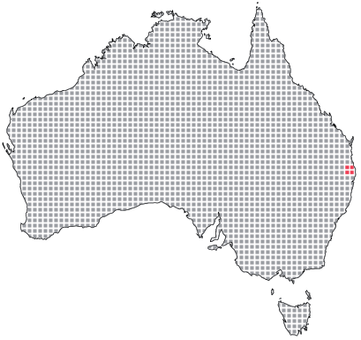
Alternative View 2
BNE

Slide 6
What we do…
A&OD collecting/testing
Nationally-accredited training
Consultancy services
Policy & procedures
Expert witness & written opinions
Set up collection & testing program
Relevant Australian Standards
Health & Safety Acts & legal considerations

Slide 7
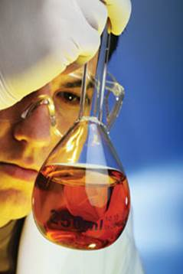



What We Do
A&D collecting/testing
Nationally-accredited training
Ideas: Break these out with images and off color text, adds to memory aid. I can continue with these themes if you agree, any ideas for consulting image????
Consultancy services
Health & Safety Acts & legal considerations
Policy & procedures
Expert witness & written opinions
Relevant Australian Standards
Set up collection & testing program
Notes:
AWDTS PRODUCTS & SERVICES
AWDTS offers the full range of alcohol and drug testing equipment and services.
Whether you are looking at setting up a collection/testing regime from scratch, or simply require one or more products and services, AWDTS is a one-stop shop providing alcohol and drug collection and testing services, nationally-accredited training and annual reaccreditation, consultancy services relating to policy & procedures, how to set up your own collection & testing program, the relevant Australian Standards and pertinent Health & Safety Acts & legal considerations. Due to the calibre of our consultants, we also offer expert witnesses for court, and a written opinion service.

Slide 8
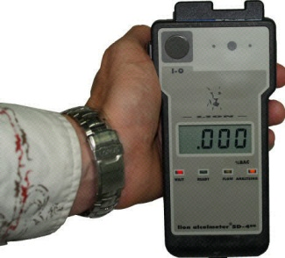
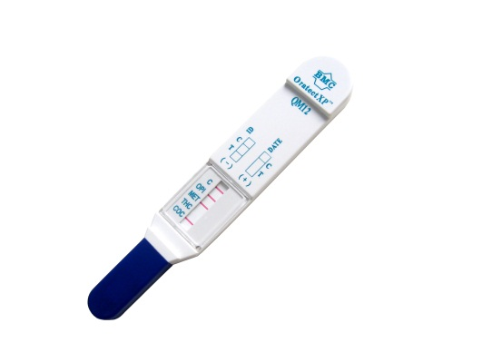
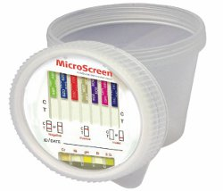
Blue Stone
Management & staff education
Management & union negotiations
Sale of testing & associated equipment
Laboratory liaison
Statistics & archiving
Specialist EAP services
Bail & Pre-Sentence Assessment/Reporting
Notes:
AWDTS provides management & staff education, negotiation and mediation services, Australia’s premier testing equipment and all necessary forms, paperwork and other equipment.
We can offer laboratory liaison, secure archiving and statistics provision, and access to a specialist Employee Assistance Program dealing with alcohol and drug related problems and in the forensic arena a full range of assessment, treatment, counselling and supervision services.

Slide 9

Blue Stone
RTO #32202 (DETA)
HLTPAT304D Collect Pathology Specimens other than Blood
HLTPAT410D Collect pathology specimens other than blood for specialised testing
Notes:
AWDTS RTO/COURSE INFO
AWDTS’ Registered Training organisation # 32202 is authorised by the Department of Education, Employment and Workplace Relations to conduct an AQTF-approved course in the testing of breath, urine and oral fluids, namely Course in Alcohol & Other Drugs Specimen Collection & Testing. The Course includes two nationally Recognised Units of Competency from the HLT7 Health Training Package:
HLTPAT304D Collect Pathology Specimens other than blood
HLTPAT410D Collect pathology specimens other than blood for specialised testing
HLTPAT304D provides instruction on collection procedures for the conduct of breath testing and use of specialised equipment for sample analysis.
HLTPAT410D provides instruction for collection procedures and the conduct of on-site testing of oral fluids and urine, packaging and despatch to a laboratory.
Feel free to check out our credentials on the NTIS site to satisfy yourself that we are able to make good our claims…only around 5 courses are available in Australia that meet the requirements of AS/NZS4308 Procedures for specimen collection and the detection and quantitation of drugs of abuse in urine and AS4760:2006 Procedures for specimen collection and the detection and quantitation of drugs in oral fluid .
There is no Standards Australia requirement for testing staff to complete an AQTF-approved course in alcohol testing. However, industry best practice and our experience with the legal system has shown time and again that if problems occur in the testing process and litigation looms, the organisation conducting the alcohol testing will have to demonstrate the competency of its testing staff to perform breath testing, and will usually be asked whether nationally-accredited training known to be available was utilised. In cases where it was not utilised, lengthy questioning of the witness(es) ensued.

